Slide 1
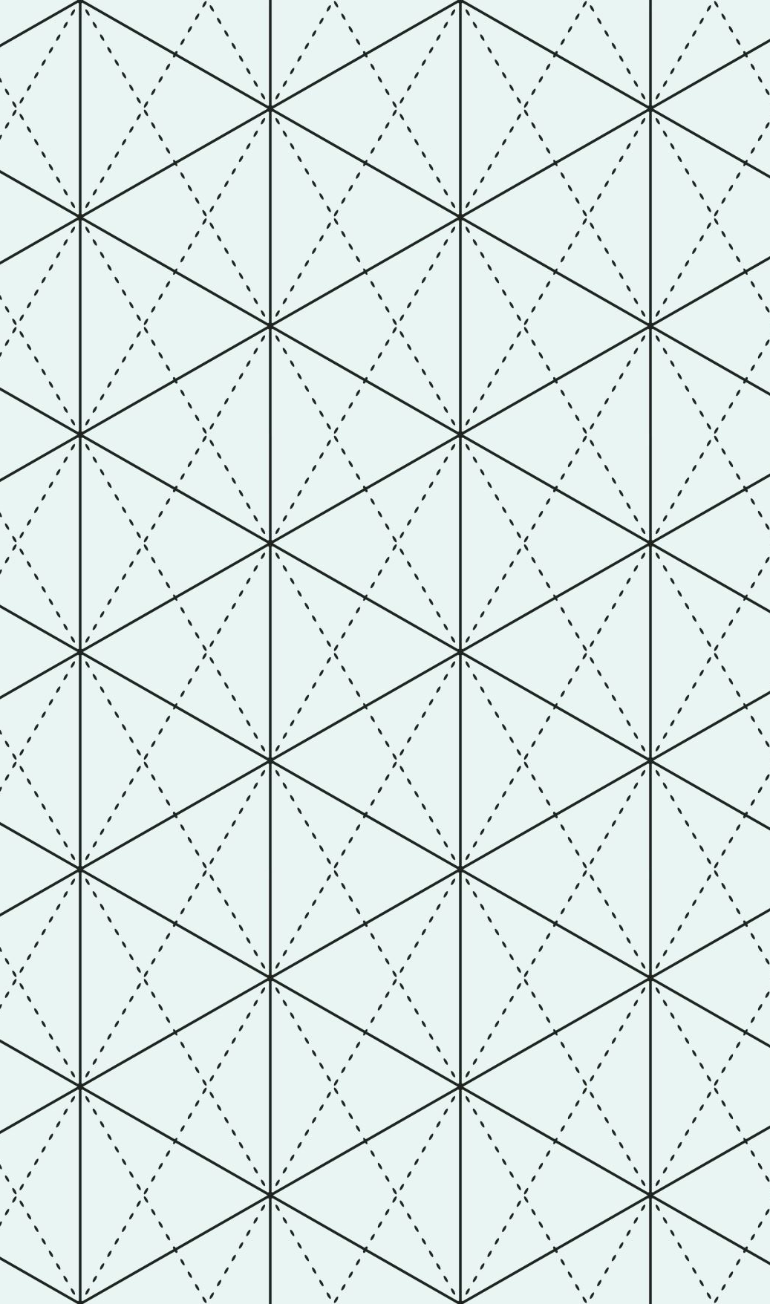
Welcome to Psy 653 Lab!
Module 01:
Nested and Incomplete Designs in ANOVAs

Slide 2
Objectives
Reviewing ANOVAs
What is a nested design?
Viewing Kevin’s nested designs
Dataset description
The “aggregate()” function (Because you saw it in lecture)
Coding tutorial

Slide 3
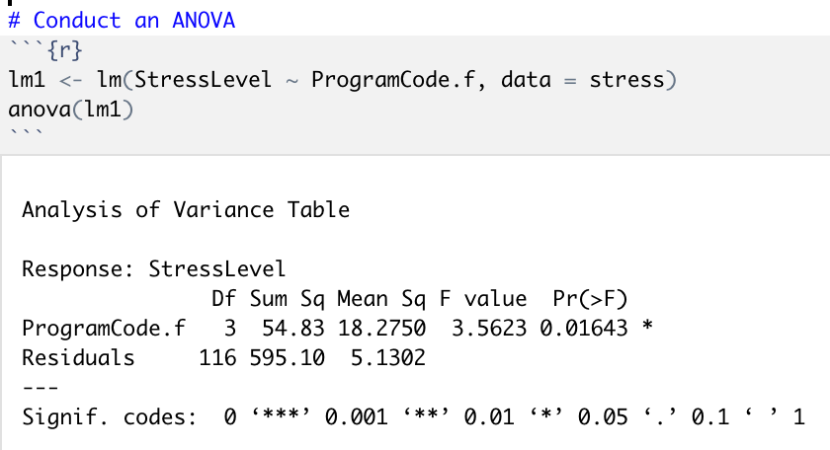
A quick review of ANOVAs
An example from last semester:
ANOVAs evaluate how a continuous outcome varies across levels of a categorical predictor(s)
Sum of squares (SS): The sum of squared deviations from each individual value and the mean
Mean square (MS): The average distance values deviate from the mean (SS/df)
F-statistic: The ratio of model mean square to the residual mean square (MS_{explained}/MS_{residual})
The p-value for the model F-test is significant at p<0.05, indicating that there was a significant effect of ProgramCode on stress level.

Slide 4
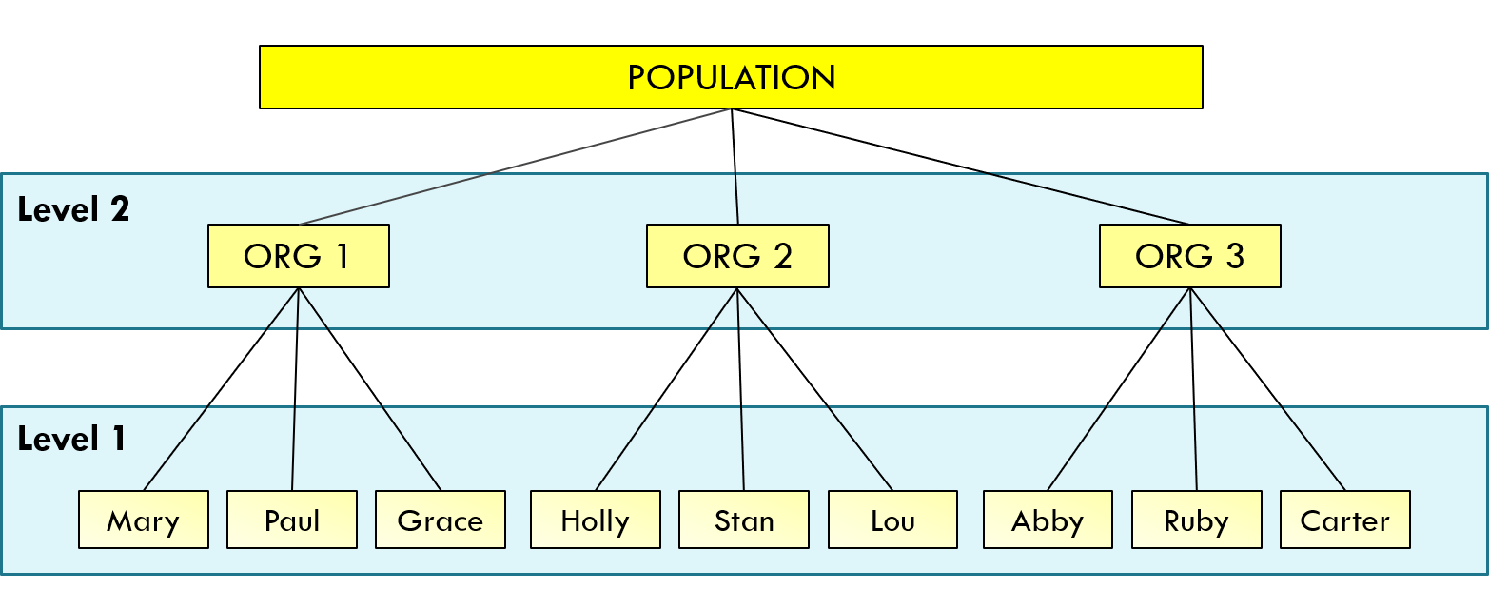
What is a nested design?
A nested design (aka hierarchical design) is when a factor(s) is nested within another factor.
A nested ANOVA (aka hierarchical ANOVA) is used to evaluate the differences within variables while taking into account the nested structure of the data
©Kimberly Henry
https://www.statisticshowto.datasciencecentral.com/nested-model-anova-factors/

Slide 5
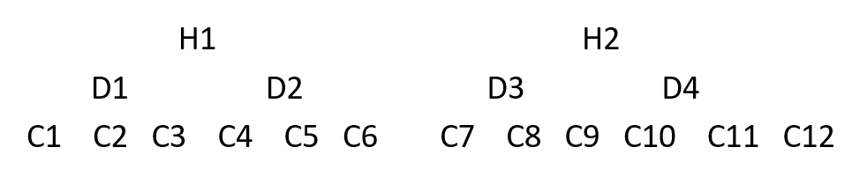
Looking at Kevin’s Nested Designs: Design 1
Drug is nested within hospital in this data, because the drugs differ between the two hospitals.
Condition is nested within hospital in this data, because the conditions differ between the two hospitals.
Condition is nested within drug & hospital, because the conditions differ between the two drugs within hospital.

Slide 6
Looking at Kevin’s Nested Designs: Design 1
You Can NOT Run any interactions with this design (It is a fully nested model).
Y ~ Hospital + Hospital/Drug + Hospital/Drug/Condition
* A “ / ” indicates a nested structure

Slide 7
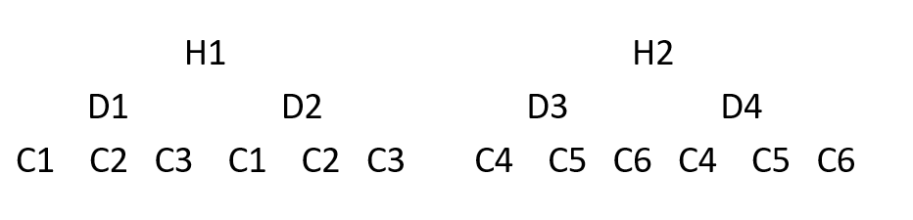
Looking at Kevin’s Nested Designs: Design 2
Drug is nested within hospital in this data, because the drugs different between the two hospitals
Condition is nested within hospital in this data, because the conditions different between the two hospitals.
Condition is NOT nested within drug, because the conditions are the same between the two drugs within hospital.

Slide 8
Looking at Kevin’s Nested Designs: Design 2
You can run ONE interaction within this design (Hospital/Drug * Hospital/Condition) because the conditions are the same within hospital.
Y ~ Hospital + Hospital/Drug + Hospital/Condition + Hospital/Drug*Hospital/Condition
* A “ / ” indicates a nested structure

Slide 9
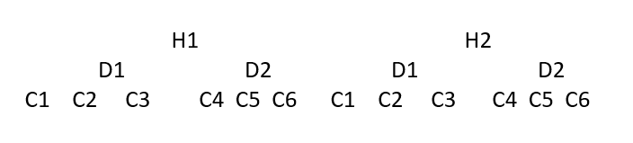
Looking at Kevin’s Nested Designs: Design 3
Drug is not nested within hospital in this data, because the drugs are the same between the two hospitals (i.e., the effects of a particular drug could be different from one hospital to the next).
Condition is not nested within hospital in this data, because the conditions are the same between the two hospitals (i.e., the effects of a particular condition could be different from one hospital to the next).
However, condition is nested within drug, because the conditions are different between the two drugs. (i.e., since each condition was not tested for each drug, we cannot assess the possibility that the different conditions are different between the drugs).
Notes:
Give overview of the design (2 hospitals, 2 drugs, 6 conditions)

Slide 10
Looking at Kevin’s Nested Designs: Design 3
You can run TWO interactions within this design (Hospital * Drug AND Hospital * Drug/Condition).
Y ~ Hospital + Drug/Condition + Hospital*Drug + Hospital*Drug/Condition
* A “ / ” indicates a nested structure
Notes:
Give overview of the design (2 hospitals, 2 drugs, 6 conditions)

Slide 11
Dataset Description
This demo uses data from 114 patients who participated in study to evaluate the effects of different drugs and treatment conditions on health.
Our overall research question:
Does patient health significantly vary across hospitals, drugs, and treatment conditions?
Outcome = Y (a proxy for health; Values can range = 1 - 15; Higher scores = better health)
Predictors = Hospital, Drug, Condition

Slide 12
Structure of the data
Notes:
Give overview of the design (2 hospitals, 2 drugs, 6 conditions)

Slide 13
Structure of the data
Drug is not nested within hospital in this data, because the drugs are the same between the two hospitals (i.e., the effects of a particular drug could be different from one hospital to the next).
Condition is not nested within hospital in this data, because the conditions are the same between the two hospitals (i.e., the effects of a particular condition could be different from one hospital to the next).
However, condition is nested within drug, because the conditions are different between the two drugs. (i.e., since each condition was not tested for each drug, we cannot assess the possibility that the different conditions are different between the drugs).
Notes:
Give overview of the design (2 hospitals, 2 drugs, 6 conditions)

Slide 14
The aggregate function, broken down (Because you saw it in lecture)
aggregate() = function
nested_demo$Y = Continuous outcome variable
Hospital = New name given for output (must be 1 word)
nested_demo$Hospital = Categorical predictor variable
mean = Desired descriptive function (i.e. mean, sd, median, etc.)

Slide 15
The aggregate function, broken down (Because you saw it in lecture)
aggregate() = function
nested_demo$Y = Continuous outcome variable
Hospital = New name given for output (must be 1 word)
nested_demo$Hospital = Categorical predictor variable
mean = Desired descriptive function (i.e. mean, sd, median, etc.)

Slide 16
Let’s Code!

